Slide 1

CUSTOMER FEEDBACK ANALYSIS USING NLP
Prepared by:
Aditi Mukherjee (22051395)
Siddhi Shriya (22051631)
Subhamita Paul (22051639)
Puja Kumari (22051446)
Amrita Pattanaik (22052188)
Amrit Raj (22053486)
Under the Guidance of :
Prof. Nachiketa Tarasia

Slide 2
CONTENTS
1. Introduction
2. Project Overview
3. Tools and Technologies
4. Dataset Used
5. Frontend and Backend Architecture
6. Vader Sentiment Analysis
7. Sample Outputs & Visuals
8. Comparison – VADER vs RoBERTa
9. Conclusion
2

Slide 3
Customer Feedback Analysis Introduction
Sentiment Analysis
.
Utilizing NLP techniques to automatically identify and categorize customer sentiments in feedback, enabling companies to gauge customer satisfaction and respond effectively.
Importance in Trend Analysis
Customer reviews contain valuable insights about product performance, user experience, and satisfaction.
By using Natural Language Processing (NLP), we can automatically detect whether feedback is positive, neutral, or negative.
This empowers companies to make data-driven decisions faster and at scale.
3

Slide 4
Project Overview
Goal: Understanding Sentiment in User-Generated Text
The primary objective of this project is to analyze the sentiment embedded in user-generated content such as customer reviews and product feedback. These texts reflect real human opinions and emotions, and extracting sentiment from them helps businesses understand how their users truly feel.
By leveraging Natural Language Processing (NLP), we can automatically classify a piece of text as positive, negative, or neutral, enabling companies to make informed decisions based on real customer voices.
4

Slide 5
Tools and Technologies
VADER (Valence Aware Dictionary and sEntiment Reasoner)
Type: Rule-based sentiment analysis tool.
Advantages:
Extremely fast and lightweight.
Optimized for short, informal text, such as social media posts, tweets, and product reviews.
Comes pre-trained with a sentiment lexicon; no additional training required.
Output: Produces four scores — positive, negative, neutral, and a compound score that represents the overall sentiment.
RoBERTa (Robustly Optimized BERT Approach)
Type: Transformer-based deep learning model from Facebook AI.
Advantages:
Highly accurate due to its deep contextual understanding of language.
Can interpret complex structures, negations, and sarcasm more effectively than rule-based models.
Fine-tuned on large datasets, making it ideal for nuanced sentiment detection in professional or detailed reviews.
Implementation: Used via Hugging Face's transformers library.

Slide 6
Tools and Technologies
Hugging Face Pipeline
Purpose: Simplifies the use of pre-trained models like RoBERTa.
Provides an easy-to-use API for sentiment analysis, making it possible to go from raw text to prediction in just a few lines of code.
Ideal for quick integration into applications or dashboards.
Development Environment
Language: Python
Platform: Jupyter Notebook for prototyping and experimentation
Libraries Used: nltk, transformers, pandas, matplotlib, etc.
6

Slide 7
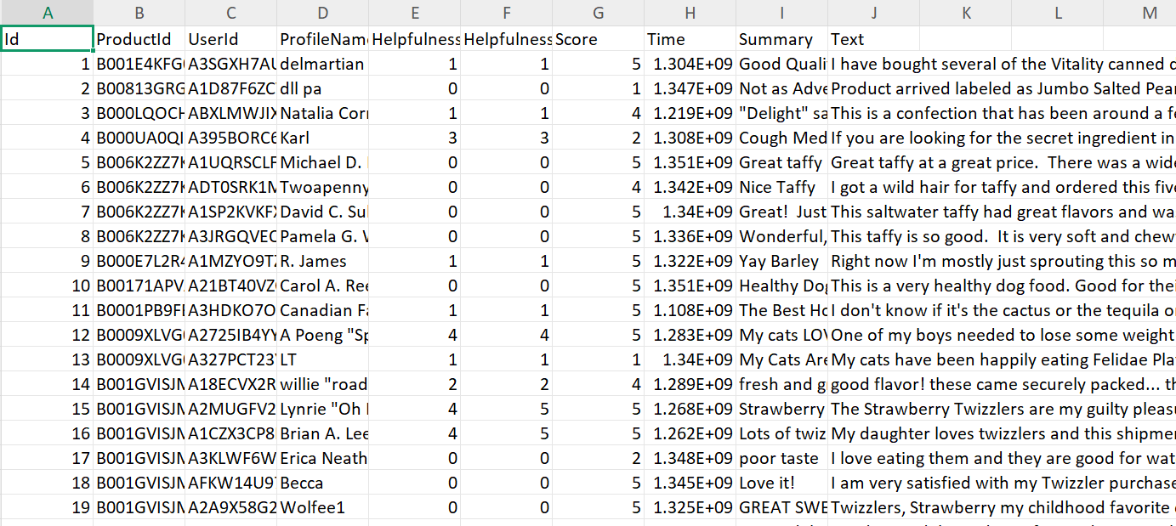
Dataset Used – Reviews.csv
Dataset Overview
The dataset used in this project is titled Reviews.csv, which contains customer-written reviews about products or services. This data forms the foundation for our sentiment analysis model, as it offers a variety of real-world textual feedback that we aim to classify as positive, neutral, or negative.
7

Slide 8
Frontend and Backend Architecture
Overview
To make sentiment analysis accessible to users, the backend logic (model predictions) is connected with a user-friendly frontend interface. This architecture enables real-time input, processing, and output display for sentiment results.
8

Slide 9
Frontend (User Interface)
The frontend allows users to enter text (like a product review or a comment) and instantly see the sentiment prediction.
Tools & Options:
Streamlit: A simple Python-based web framework for creating dashboards and ML web apps.
Alternative: HTML + CSS + JavaScript with Flask or FastAPI as the backend.
UI Elements:
Text input box
“Analyze Sentiment” button
Output display (e.g., Positive/Negative/Neutral with score)
Optional: pie charts, bar graphs, emojis for visual appeal
9

Slide 10
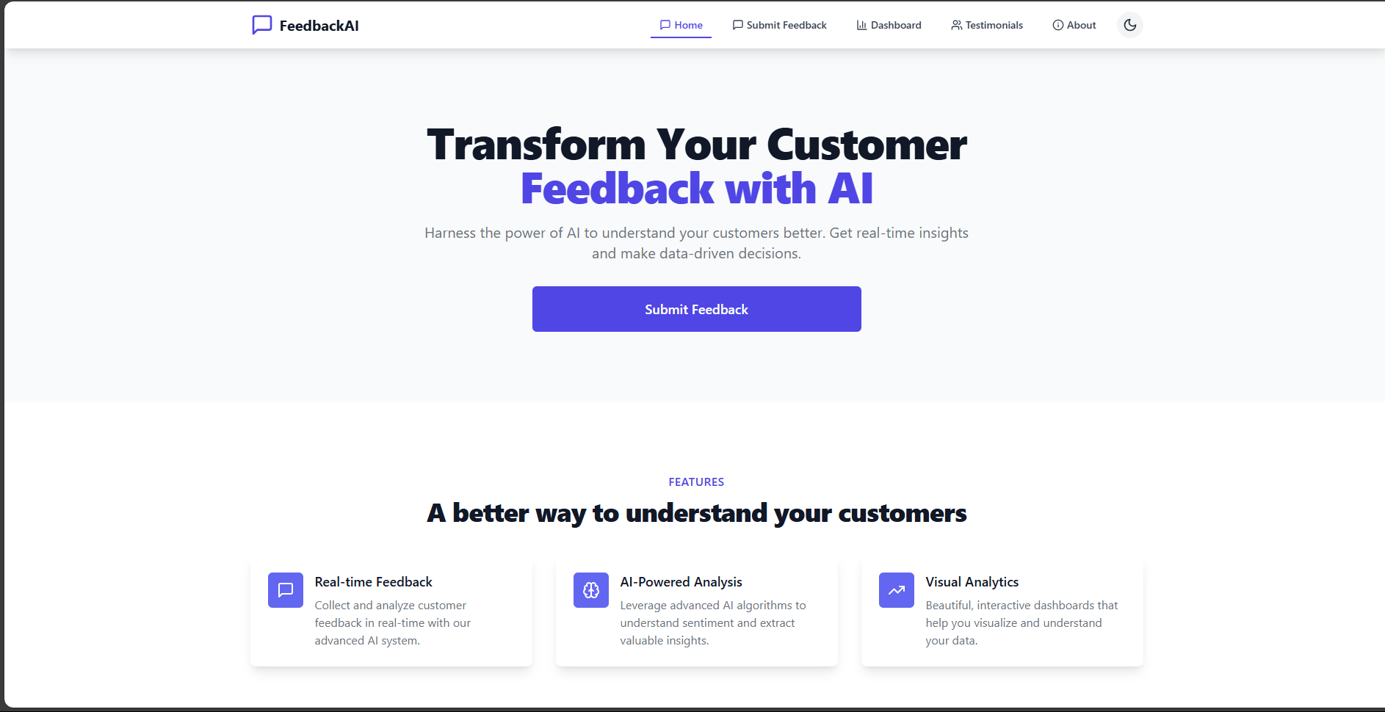
10

Slide 11
Backend (Processing Engine)
The backend performs the actual sentiment analysis using either:
VADER (NLTK)
RoBERTa (via Hugging Face Transformers)
Tasks Performed:
Technologies:
Receives input from the frontend
Processes the text using the selected model
Sends sentiment result (label + confidence score) back to the frontend
Python
Flask or FastAPI (to build REST APIs)
Model Libraries: nltk, transformers, torch
11

Slide 12
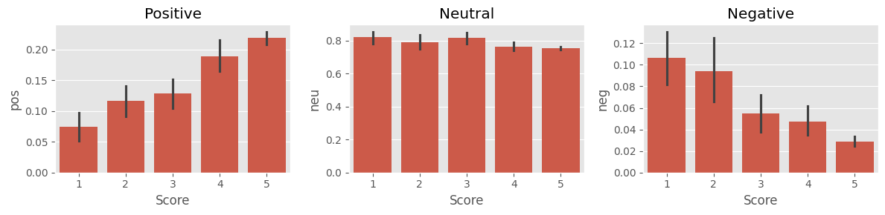
VADER Sentiment Analysis
VADER (Valence Aware Dictionary and sEntiment Reasoner) is a rule-based sentiment analysis tool that is specially designed to detect sentiment in social media, customer reviews, and short texts. It is part of the NLTK (Natural Language Toolkit) library in Python.
VADER does not require any training data and comes with a predefined sentiment lexicon, making it extremely fast and easy to use — ideal for real-time applications or systems with limited computing resources.
Tool Used: NLTK's VADER (Valence Aware Dictionary and sEntiment Reasoner)
Functionality: Assigns sentiment scores (positive, neutral, negative, compound)
12

Slide 13
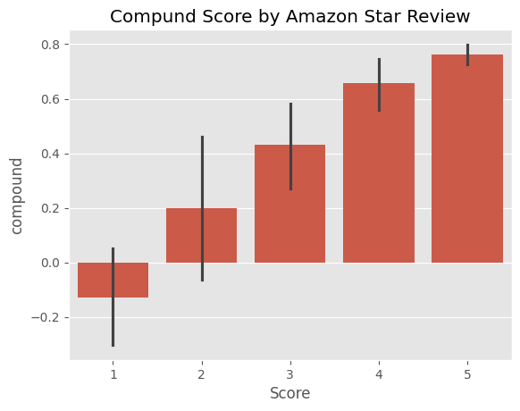
Plot VADER Result

Slide 14
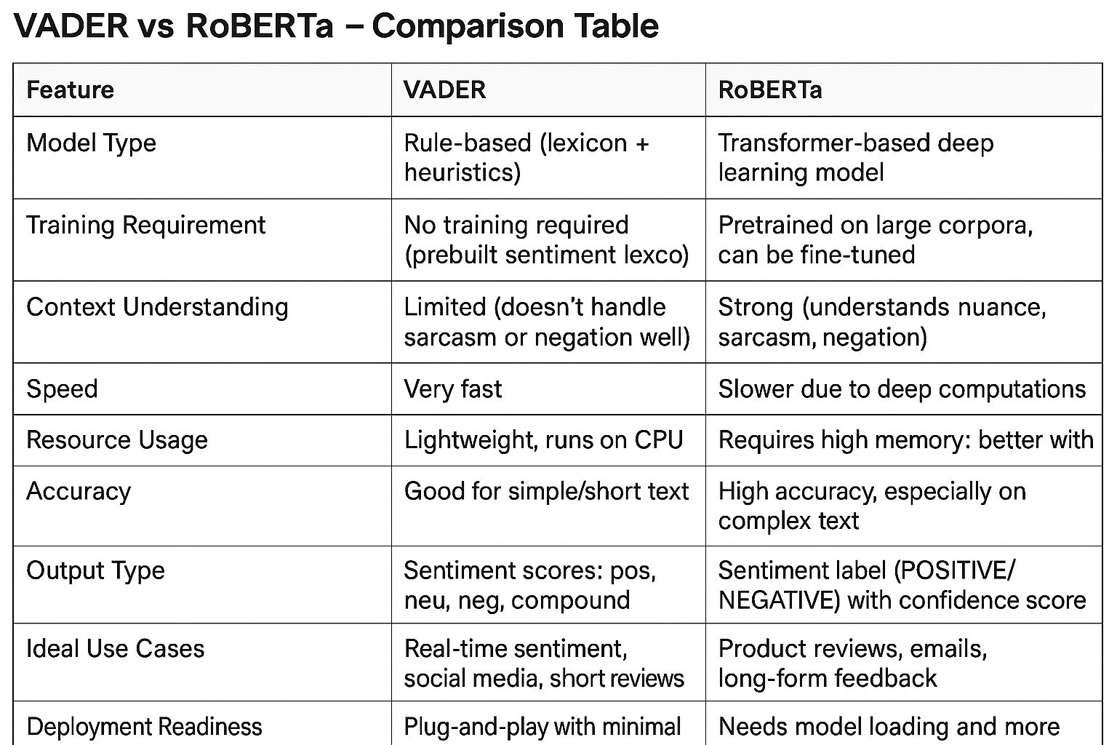
14

Slide 15
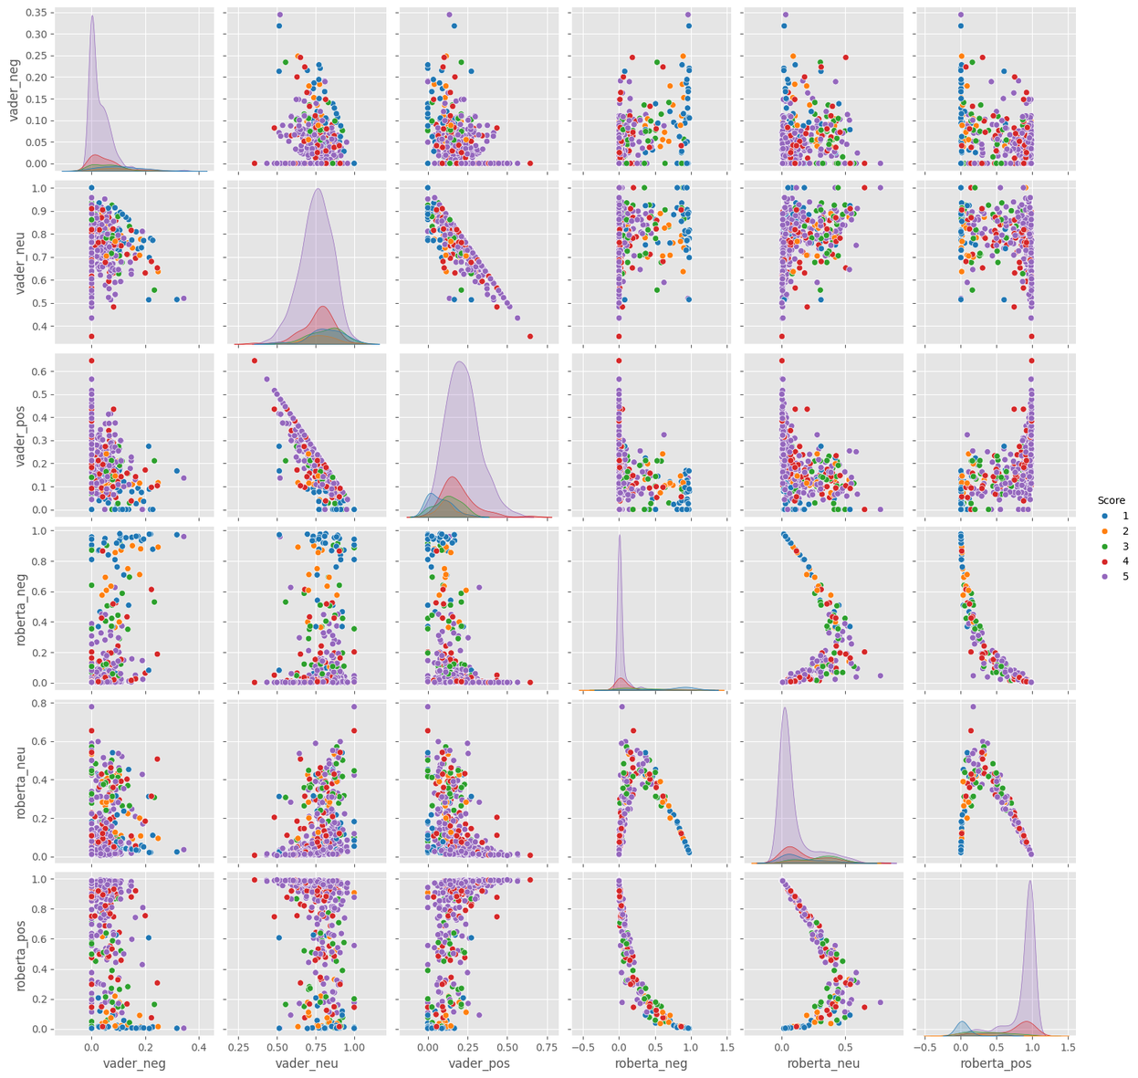
Combine and Compare (Vader vs Roberta)
15

Slide 16
Conclusion
1. Both Models Have Their Place
VADER is ideal for quick, rule-based sentiment analysis, especially in real-time and lightweight applications like social media or chat interfaces.
RoBERTa, a transformer-based model, excels in accuracy and context comprehension, making it perfect for detailed feedback, reviews, and long-form text.
2. Easy Access via Hugging Face
The Hugging Face Transformers library makes it simple to:
Load pre-trained models like RoBERTa
Perform inference with just a few lines of code
Avoid complex model training or infrastructure setup
3. Deep Learning Offers Accuracy at a Cost
RoBERTa significantly outperforms rule-based systems in accuracy, especially on nuanced or ambiguous sentences.
However, it requires more resources and time, so it’s better suited for applications where precision matters more than speed.
16

Slide 17

Thank you!

